Slide 9
Publification
“Erstiheft”
If we get the go from Fachschaft we can send a mail via the informatik mailing list

Slide 10
Future Ideas/ Sustainability
If the /log site registers an error then an agent gets the message and looks more into it, if the side is broken and if there is a code fix for this
We could implement automatic scrapes that scrape our sources increasingly more often the closer the semester start is
The tool outlives us with the help of the “Fachschaft”

Slide 11
Study OS - Study Planner
Emre Emre, Yonatan Dankner, Lena Binder, Ben

Slide 12
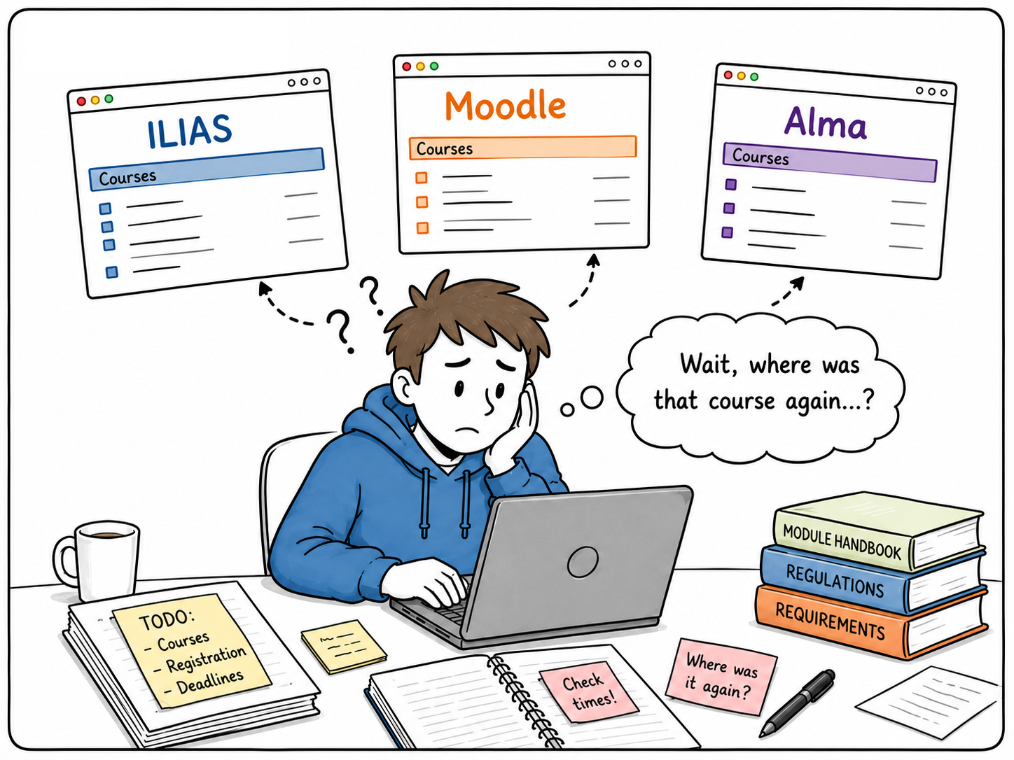
Notes:
Semester planning often starts with the same question: where is the information I actually need?

Slide 13
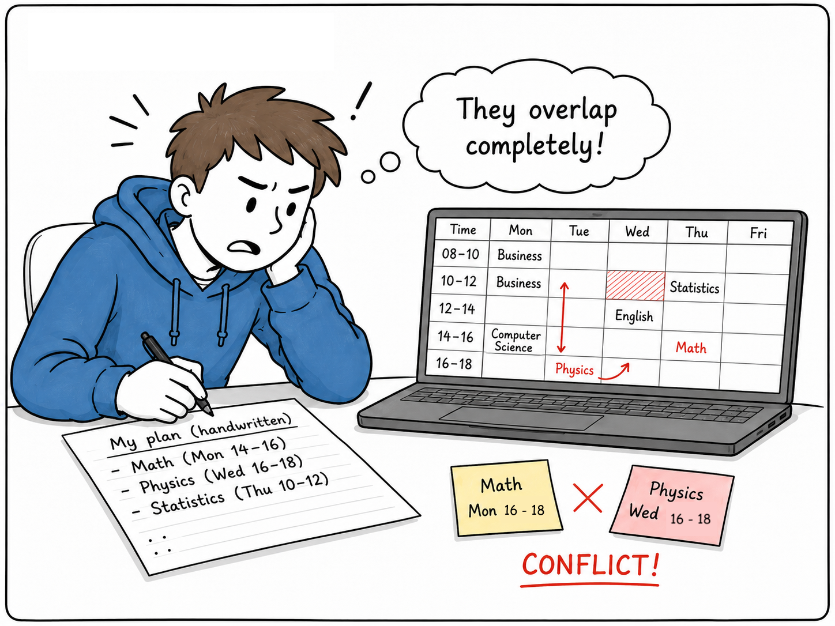
Notes:
Once the courses are found, the next challenge begins: fitting them into one schedule without overlaps.

Slide 14
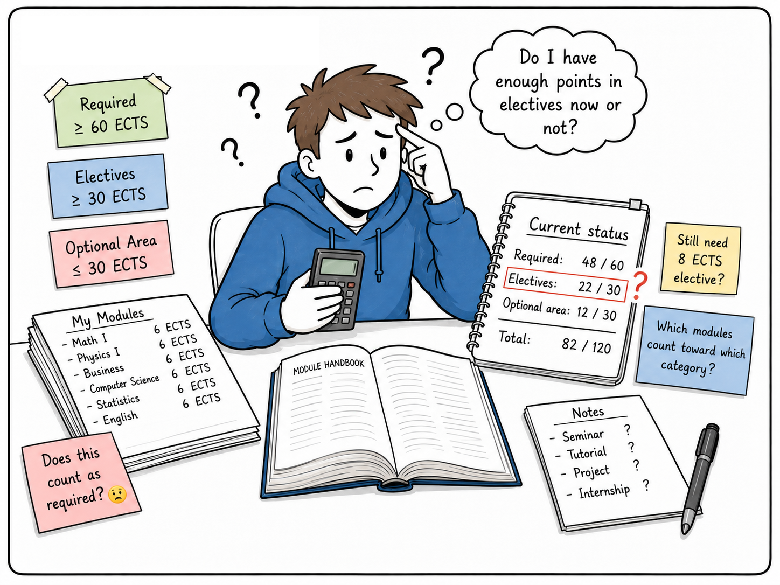
Notes:
And even then, it is not always clear which requirements are already fulfilled and what is still missing.

Slide 15
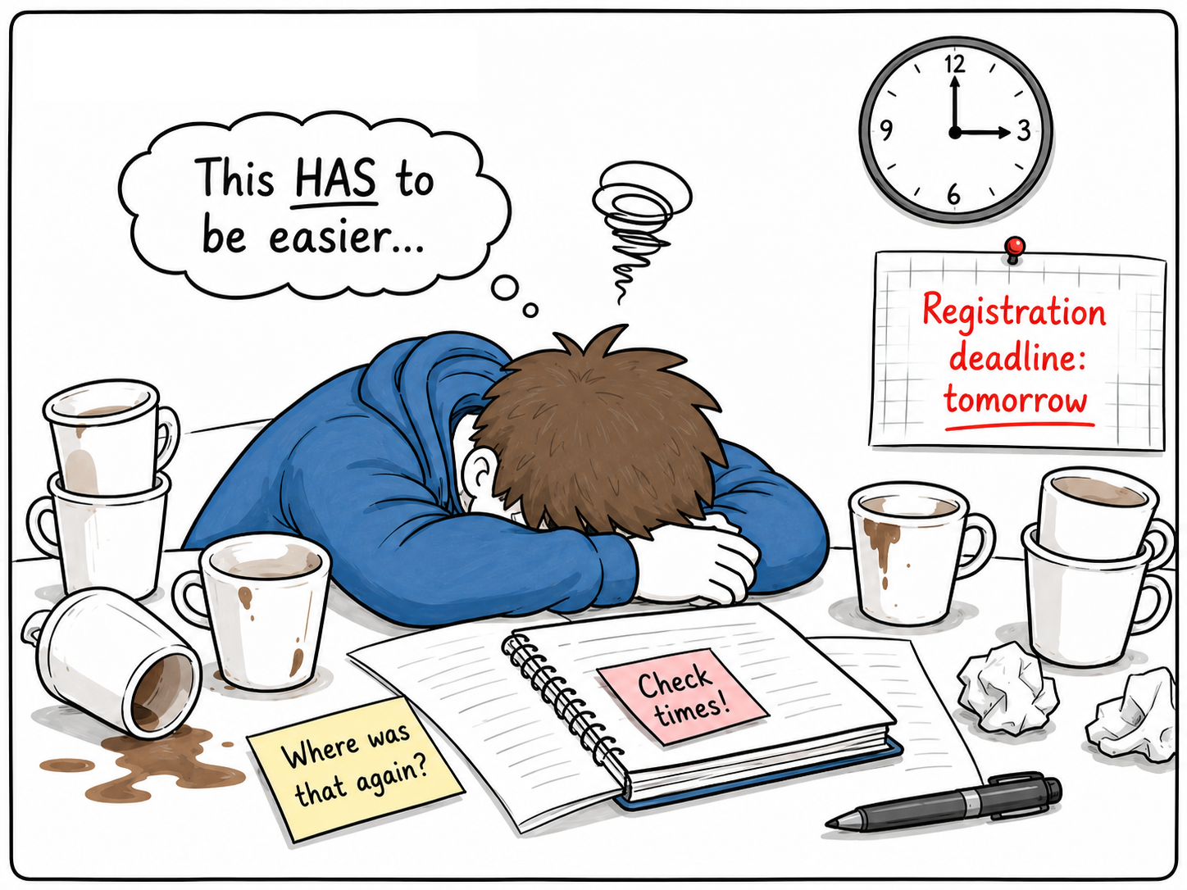
Notes:
So what should be a simple planning task quickly turns into a mix of platforms, spreadsheets, notes, and uncertainty.That is the problem StudyOS was designed to solve.

Slide 16
Students struggle with semester planning because course information is fragmented, scheduling is difficult, and tracking progress toward degree requirements requires significant manual effort.
Notes:
We started with the initial problem definition that…

Slide 17
Initial assumptions & Target group
Students regularly use all three platforms during semester planning
The main issue was the amount of time required to search for and combine information
Most students use spreadsheets and notes etc. to create their schedules and keep track of their study progress
Students frequently struggle to understand how completed courses count toward specific ECTS categories
A centralized application would reduce effort and prevent mistakes.
Target group: Computer Science bachelor’s and master’s students who are actively planning their semester and need to select courses, create a conflict-free schedule, and track their degree progress.
Notes:
At first we assumed that…

Slide 18
Students lack a single, reliable place to discover relevant courses, create a conflict-free semester schedule, and understand their progress toward degree requirements. Because information is distributed across disconnected systems, students must manually combine, verify, and maintain it, which is time-consuming, error-prone, and difficult to understand.
Notes:
AT the end out final problem statement was that…

Slide 19
Initial view: The main issue was the lack of centralized access to course information.
Refined view: The broader challenge is the manual effort required to combine, verify, and interpret information for scheduling and degree progress tracking.
Notes:
So initially, we viewed the problem mainly as a lack of centralized access to course information.
Through further analysis, we realized that the main challenge was broader: students not only need to find information, but also have to combine, verify, and interpret it for scheduling and degree progress tracking.
Therefore, we refined the problem statement to focus on the entire semester planning process and the manual effort caused by disconnected systems.

Slide 20
We solve fragmented and manual semester planning for students by bringing course information, conflict-free scheduling, and degree progress tracking into one central application.
1. Course discovery and information: We help students find relevant and reliable course information by combining data from different university platforms in one catalog.
2. Scheduling: We help students create conflict-free semester schedules by automatically detecting overlaps and supporting course selection.
3. Degree progress: We help students understand their academic progress by automatically assigning completed courses to degree requirement categories.
Notes:
Based on these insights, we were able to clearly define who we are designing for, which problem we want to solve, and how StudyOS addresses it. That is…

Slide 21
User Research, evidence
We were all missing this tool, this was the starting point
We asked friends about their experience
Got feedback that the process was tedious, course discovery is hard
Notes:
Yonatan

Slide 22
Concept, Solution Design (Ben)

Slide 23
Concept and solution design - Proposed tool (Ben)

Slide 24
Concept and solution design - value proposition (Ben)

Slide 25
Concept and solution design - technical choices (Ben)
Website and Data in Cloudflare
Code in Github
Big DB with small sub tables in SQLite

Slide 26
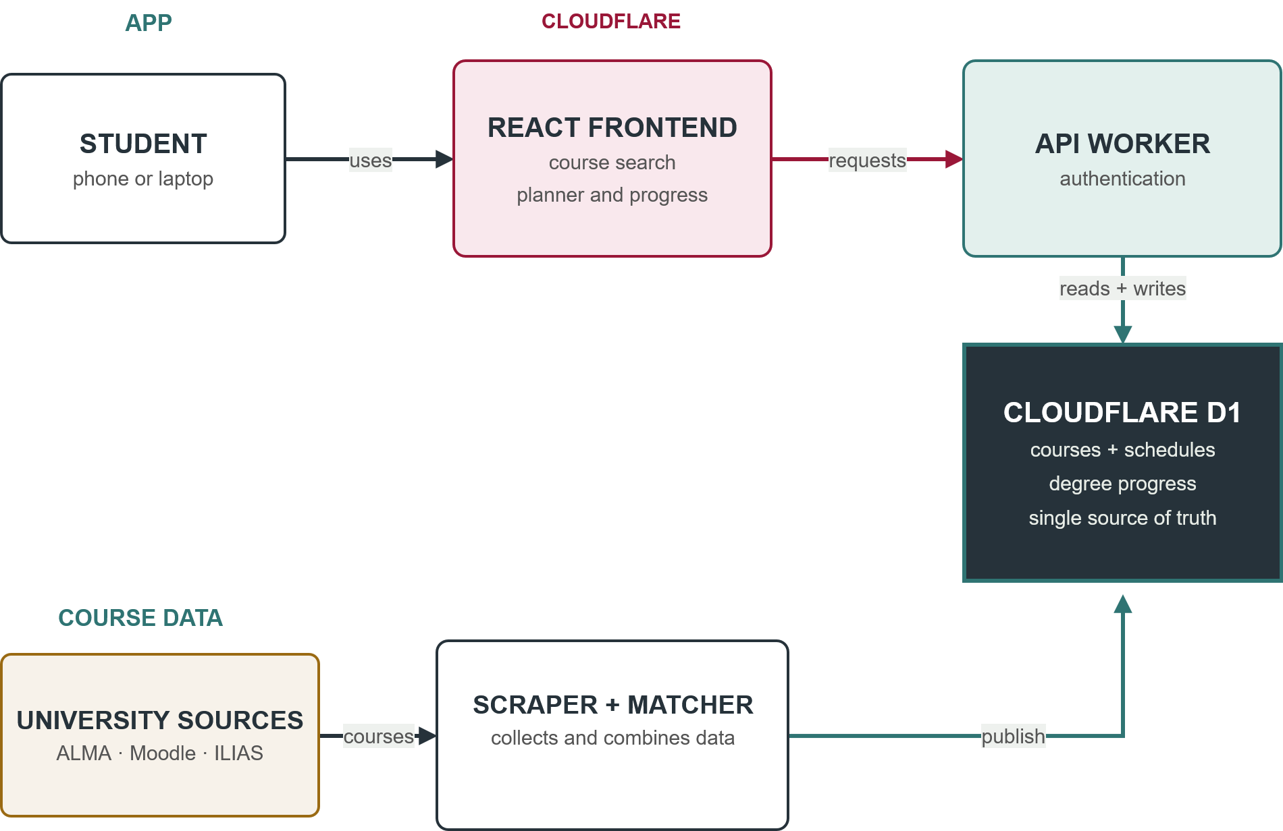

Slide 27
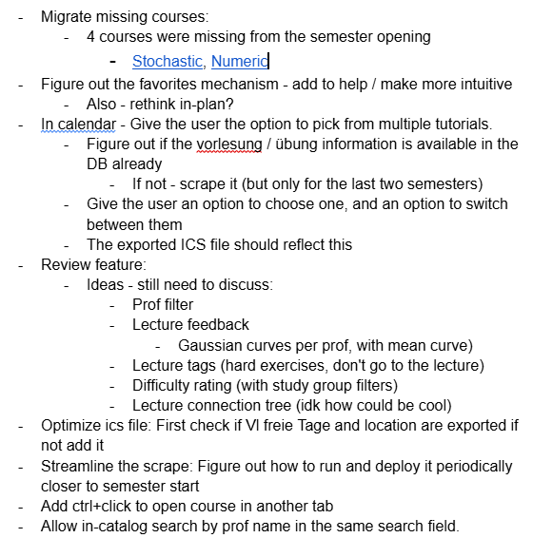
Iteration
Weekly sync meeting on Sundays and Thursdays
Kept track of open issues and assignment on a google doc
Show old Claude design prototypes?
Notes:
Yonatan - We’ve met every week on Sundays and sometimes on Thursdays to discuss prioritization, features and bugfixes
We managed an active list of features and bugs to fix
In hindsight it might have been useful to have a kanban thingy like Jira, since the google doc kept getting messy, but in practice it was enough for our purpose

Slide 28
Testing
Lena Ran two 1-hour testing session with two friends, got detailed results
Testing in the Study OS session
We got the 500 error bug,
Repeated testing ourselves in weekly meetings
Notes:
Yonatan In the study OS session we took note on ideas and feedback, and implemented them in

Slide 29
Where we’re at (Emre)
Quick overview of features
Course catalog
Favorites for collecting interesting courses
Semester planner with weekly schedule view
Regulation/progress overview for study requirements
ToR import
Course balancer
TODO: I think this has to go somewhere else

Slide 30
What’s still missing (Emre)
Anonymous Course Review
Student can leave a short rating/comment after taking a course
difficulty , workload, teaching style
Moderation -> hate speech, fair treatment of profs
Registration Notification
Some courses open registration on a specific data and have limited participants
Automated Data Update Pipeline
Current scraper can collect data from alma, moodle and Ilias
Automate the pipeline with GitHub Actions
Scraper runs regularly before the new new semester and would not be needed during semester

Slide 31
Lessons learned (Ben)
Claude helps, but requires some babysitting

Slide 33
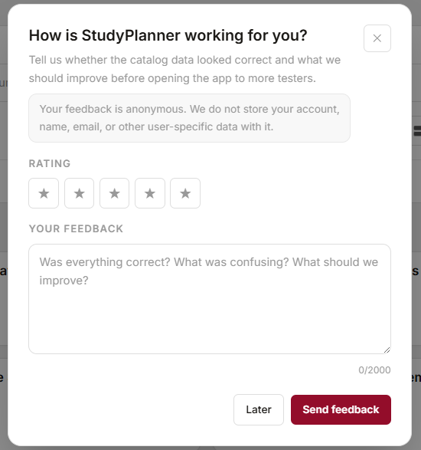
Questions?

